Slide 1



The USAID/FEMA Operational Blueprint
For Disaster Relief and Reconstruction in the FSM
Presented by:
Notes:
Quick brief on what is DHS/FEMA and OFDA/USAID

Slide 2


USAID/FEMA Operational Blueprint
Purpose & Scope
To provide a general operational framework:
With consideration of the terms of the Compacts Agreements
How USAID and FEMA coordinates and delivers USG supplemental disaster assistance to FSM
Following a US Presidential Declared Disaster

Slide 3
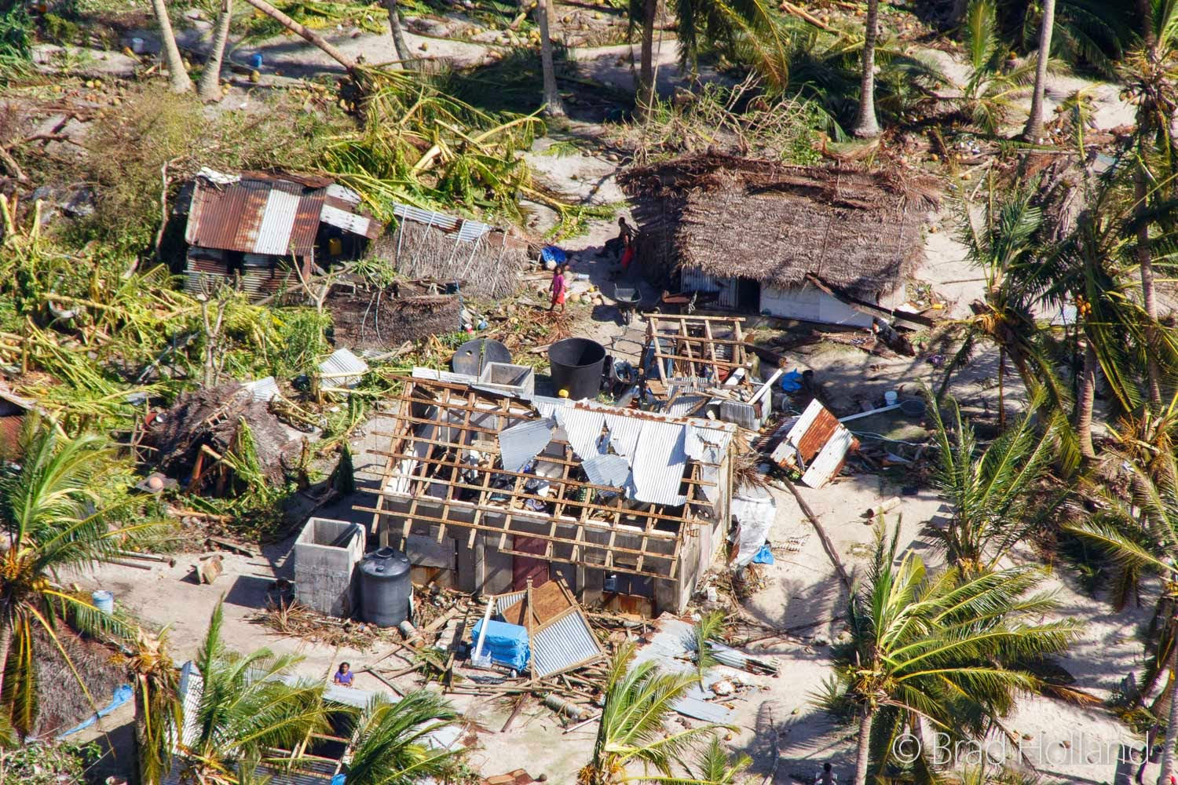
USAID/FEMA Operational Blueprint
USG responds to rapid & slow onset disasters
Purpose & Scope
Where an intensive intervention is necessary to save lives and protect property, public health, and safety
IT DOES NOT…
describe every action that may be required or every combination of challenges that may arise.
address long-term assistance for ongoing economic or environmental threats, nor programmatic costs including mitigation.

Slide 4
USAID/FEMA Operational Blueprint
Critical Considerations
National and state/local governments have the primary responsibility of providing response and recovery services.
USG disaster assistance is supplemental.
For disasters that are not declared by the President of the United States, USAID will respond in the FSM in the same manner it does worldwide.
It is envisaged that USAID will work with one or more implementing partners to provide disaster assistance.

Slide 5


USAID/FEMA Operational Blueprint
Roles & Responsibilities
COMPACT NATIONS
The Compact Nation is responsible for pre-disaster planning, pre-disaster emergency mobilization, immediate post-disaster relief operations including:
Evacuation and sheltering of those affected
Reestablishing communications (internal & external)
Clearing debris (from roads, airport runways & ports)
Providing emergency medical and other services – for saving lives and preserving public health,
Providing information & making specific requests

Slide 6

USAID/FEMA Operational Blueprint
Roles & Responsibilities
U.S. EMBASSY
The US Embassy is the representative to the US Government (USG) for the FSM and roles include:
Coordination with the FSM National Gov.
Coordination/concurrence regarding the Disaster Assistance Emergency Fund (DAEF)
Monitoring the situation

Slide 7

USAID/FEMA Operational Blueprint
Roles & Responsibilities
USAID/OFDA
USAID is the US agency that provides post disaster relief and reconstruction assistance to the compact nation.
Develops a plan for relief and reconstruction assistance and activities.
Coordinates the implementation with chosen Implementation Partners.
Monitors implementation and coordinates with stakeholders.

Slide 8

USAID/FEMA Operational Blueprint
Roles & Responsibilities
DHS / FEMA
FEMA is responsible for processing the US Presidential Disaster Declaration (PDD) request:
Participates in the Joint Damage Assessments so they can advise the Whitehouse.
Advises the Whitehouse regarding a US PDD
If there is a US PDD, FEMA approves plans for and finances USAID for the relief and reconstruction operations in the FSM

Slide 9

USAID/FEMA Operational Blueprint
Roles & Responsibilities
IMPLEMENTING PARTNERS
Implementing Partners (IPs) selected by USAID will carry our relief and reconstruction activities in accordance with USAID direction and plans.
USAID may select multiple IPs
IPs, using designated funds, are limited to the approved plans which define the beneficiaries and activities.
IPs may use sub-grantees/subcontractors to fulfill relief and reconstruction activities.

Slide 10

USAID/FEMA Operational Blueprint
Disaster Assistance Emergency Fund
Key Processes
DAEF
The affected nation should begin utilizing its own funds, including the DAEF.
US COM is responsible for validating requests to withdrawal, and concurring with requests of $50,000 +, or more than $100,000 in one calendar year
The Compact Nation is required to inform the US Embassy how the funds will be used

Slide 11
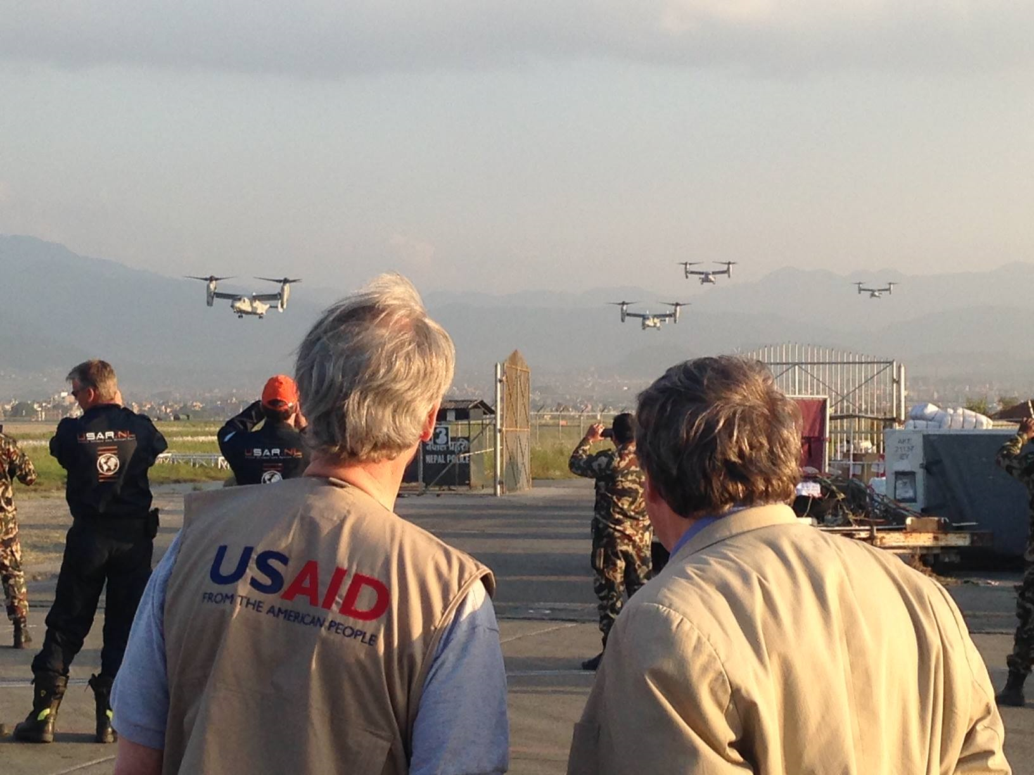
USAID/FEMA Operational Blueprint
Joint Damage Assessment
Key Processes
JDA
Requested by the affected compact nation
  within 10 days of the FSM/RMI Declaration
  includes a comprehensive list of damages
For the purpose of:
  Validating disaster related Damages to determine if USG supplemental disaster assistance is warranted,
  to inform response and reconstruction planning.
Requires participation of FEMA, USAID, FSM National Gov & Local/State Gov.
Should be completed in no longer than 30 days

Slide 12
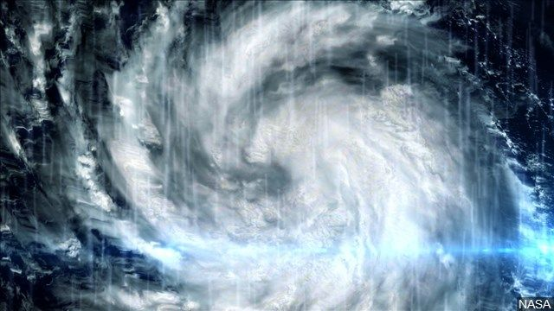
USAID/FEMA Operational Blueprint
Key Processes
Abbreviated JDA
For situations where a catastrophe is of unusual severity and magnitude
For the purpose of expediting a US PDD Request
A full JDA will still be conducted.

Slide 13

USAID/FEMA Operational Blueprint
Request for a US Presidentially Declared Disaster
Key Processes
Request for a U.S. PDD
Requested formally and in writing by the FSM/RMI President to the USG within 60 days of the Nations own disaster declaration, and typically following the completion of the JDA.
Other requirements:
  A disaster declaration by the affected nation
  Utilization of its own recourses (including DAEF)
  Formal request to the UN for assistance (written)
The US President’s decisions will be provided to the requesting nation by the US Embassy’s COM.

Slide 14
USAID/FEMA Operational Blueprint
Community & State Level
The usual flow / Timeline
HAZARD
EVENT
State DCO compiles Initial Damage Assessment Information, Reports to SDC, and SDC reports to Governor.
Governor elects to declare a state of emergency, and begins using its own resources to respond to immediate needs.
TIME
Mayors use Initial Damage Assessment forms to collect information on the current situation & report to the State DCO.
If it is within the State’s means and capacity to respond and meet all of the needs, then there is no further escalations.
If it is NOT within the State Capacity to respond and to meet the need, then the Governor Declares a State of Disaster & formally requests assistance from the FSM Government along with a situation report & action plan.

Slide 15

USAID/FEMA Operational Blueprint
National Level
The usual flow / Timeline
FSM President receives the state request, may choose to validate the damages, may declare a state of Emergency. The FSM Government may release FSM resources for the state to respond. This may include the reallocation of FSM funds and the utilization of the DAEF.
If it is within the National Government’s means and capacity to respond and meet all of the needs, then there is no further escalations.
TIME
During this time, the FSM continues to respond and collect information. The FSM may request assistance from the UN, or other donors.
If it is NOT within the National Government’s capacity to respond and to meet the need, then the President declares a State of Disaster, and formally requests of the US COM for a JDA - within 10 days of the disaster declaration - which should include a situation report and a full list of Damages.

Slide 16
USAID/FEMA Operational Blueprint
Coordination w/ USG
The usual flow / Timeline
The US COM receives the request for a JDA, along with a situation report and other supporting documents. The US COM may declare a disaster to trigger US assistance. The US COM relays the request with USAID & FEMA.
The USG JDA team briefs the US COM
The USG JDA team briefs the National Government. The President May or may not request the US for a PDD.
If the President of the affected nation chooses not to request a US PDD, response may continue outside of assistance outlined in the OBP.
TIME
USAID & FEMA coordinate JDA with the implied expectation* that the JDA commences within 15 days.
*Based on the timeframes
mentioned in the OBP
The JDA is conducted.
It is the expectation to have the JDA completed within 30 days from the start.
Within 60 days of the National disaster declaration, the President of the affected nation requests to the US COM for a US PDD, and continued US assistance.
The US COM relays to the FSM/RMI President of the decisions regarding the US PDD.

Slide 17
USAID/FEMA Operational Blueprint
General Considerations
When Submitting information it should be:
Written
Delivered with a full copy for the recipient to acknowledge the receipt.

Slide 18
USAID/FEMA Operational Blueprint
1
    Damage to
    Public Infrastructure
1
PDD Considerations
Public infrastructure damage and destruction required supplementary assistance that exceeds $1 million USD
over and above other sources available to the FSM government, including amounts to be used from the DAEF as of the date of the affected nation’s request for a PDD.

Slide 19
USAID/FEMA Operational Blueprint
2
    Destroyed Homes
2
PDD Considerations
100+ primary residence - main sleeping homes
in the affected nation have been completely destroyed.

Slide 20
USAID/FEMA Operational Blueprint
3
    Humanitarian &
    Life Saving Needs
3
PDD Considerations
As defined by minimum Sphere standards,
impact on human life, health, and safety from extreme drought or other extraordinary cause has reached an acute crisis level,
where the response costs immediately necessary to alleviate life-sustaining needs—such as safe drinking water, food, agriculture, and health services—are estimated to exceed $1 million USD
over and above the DAEF and other sources.

Slide 21
Thank you for you attention & participation
Presented by:

