Slide 1
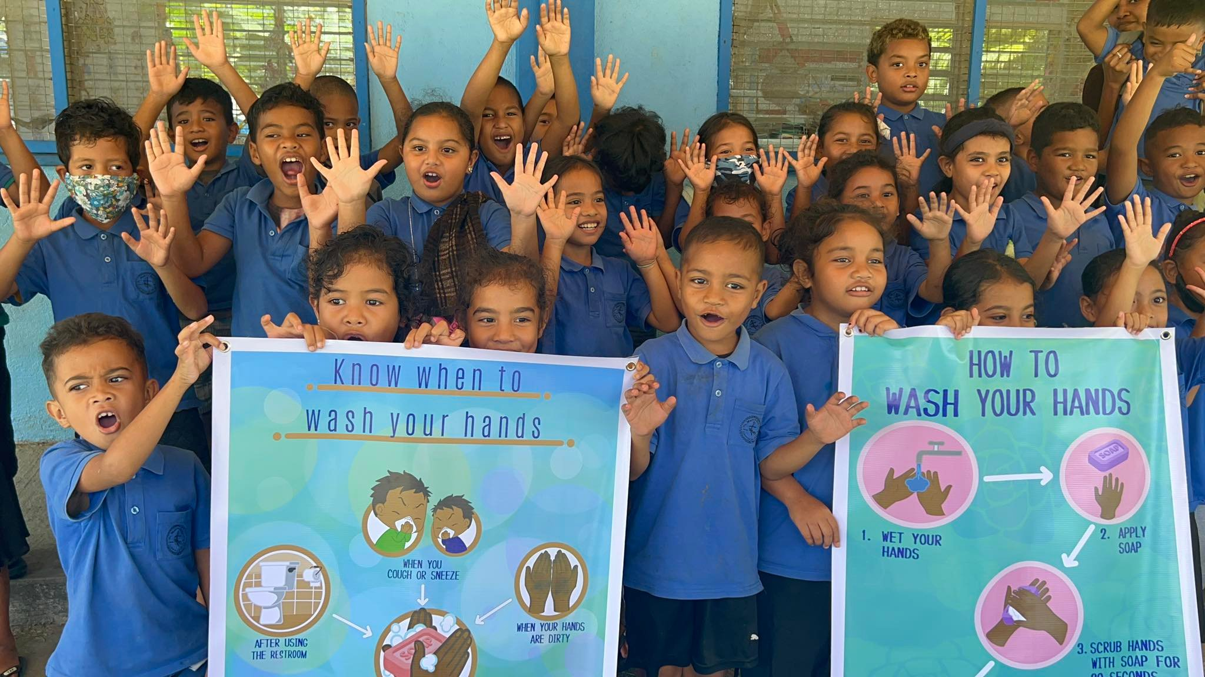

Emergency Procedures
- Strengthening WASH Anticipatory Action, Preparedness & Response -
Emergency
Procedures
Jeffrey Ing 26 October 2023

Slide 2
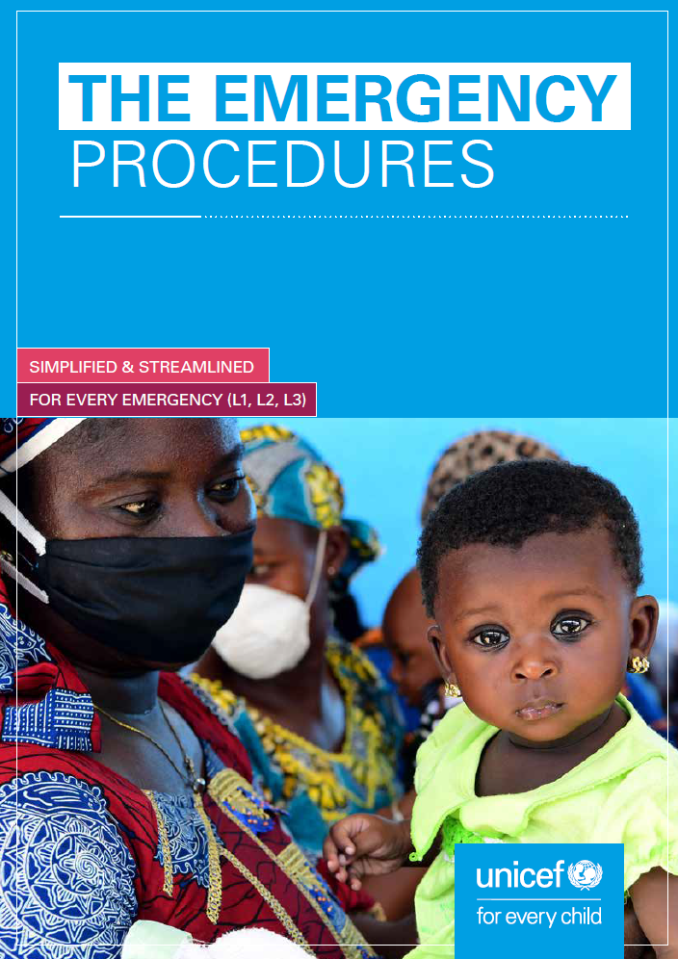
Presentation outline
Emergency
Procedures
Overview of UNICEF’s Emergency Procedures
Sector Coordination
Implementation Modalities
Prepositioning Supplies
Notes:
UNICEF’s Emergency Procedures set out a streamlined mechanism for organization-wide mobilization to support the timely delivery of humanitarian response. This includes the immediate deployment of financial, human and material resources and a set of fast-track procedures and mechanisms to enable the rapid delivery of humanitarian response, timely decision-making and effective partnerships.

Slide 3
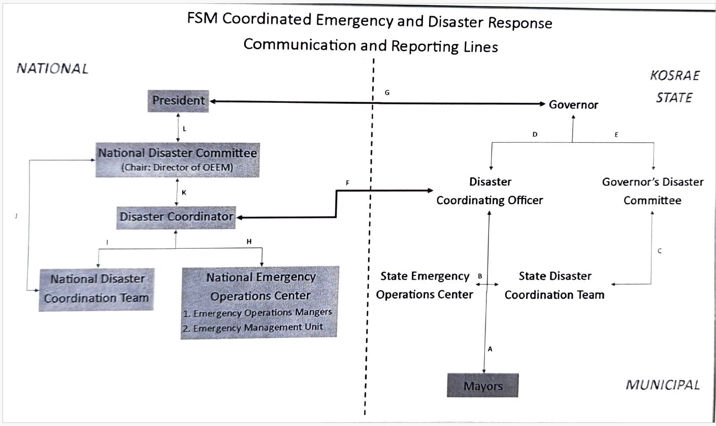

Slide 4
Programmatic approach
International Legal Framework (Convention of the Rights of the Child…)
Health & Nutrition
WASH
Gender, Disabilities, Early Child, Adolescents
People affected
Humanitarian and Development, Climate change, SBC, Cash
Protection
Education
Global Norms and Standards (Sphere, IASC…)

Slide 5
UNICEF EMERGENCY PROCEDURES
What are the key definitions? and when to apply them?
UNICEF’s definition of an emergency is aligned with the IASC’s: a situation that threatens the lives and well-being of large numbers of a population and requires extraordinary action to ensure their survival, care and protection.
Emergency
Procedures
Classification of the emergency
When crises or emergencies occur, UNICEF classifies them according to 4 criteria:
scale;
urgency;
complexity;
and capacity of Regional Office (RO) and Country Offices (COs) affected by the crisis.
Notes:
The Inter-Agency Standing Committee (IASC) is an inter-agency forum of United Nations and non-UN humanitarian partners founded in 1991 to strengthen humanitarian assistance.
UNICEF’s response to an emergency is in support of national authorities through the interagency (IA) system and partnerships. UNICEF’s level of response is determined by an analysis of the situation, the needs of children and women, the lead and capacity of government and other partners to respond, UNICEF’s own capacity to respond in line with the CCCs and its responsibilities and accountabilities for broader sector response and within the sector. The magnitude of the response will be influenced by the degree to which risks have been prevented and/or mitigated and preparedness of the country, UNICEF and partners.
CCCs – constitute UNICEF’s central policy on how to uphold the rights of children affected by humanitarian crisis
Interagency criteria used by UNICEF for analysis of the situation are:
Scale – factors: size of affected areas, number of affected / potentially affected children and women, number of countries affected
Urgency – factors: importance of population displacement, intensity of armed conflict (importance requiring swift action)
Complexity – factors: multi layered emergency, multiple affected countries/across regions, presence of a multitude of actors, lack of humanitarian access, high security risks to staff
Capacity – factors: low national response capacity, weak/fragile state, needs outweigh the capacity of CO/ RO to respond

Slide 6
UNICEF EMERGENCY PROCEDURES
This classification allows the determination of the response:
Level 1 The scale of an emergency is such that a country office can respond using its own staff, funding, supplies and other resources, and the usual regional office/headquarters support.
Any emergency with a stand-alone HAC (Humanitarian Action for Children) appeal - which is not an L3 or L2 emergency - is an L1 emergency. A stand-alone HAC can be either single-country or multi-country (e.g. migration, refugee or natural disaster-related HACs). It does not cover general regional HACs.
Level 2 CO needs additional support from other parts of the organisation (HQ, RO and other COs) to scale up and respond to the crisis. The Regional Director will provide leadership and RO support is enhanced.
Level 3 The Executive Director declares that organisation-wide mobilization is needed to scale up and respond, and appoints a Global Emergency Coordinator. RO support to the CO is enhanced
Emergency
Procedures
Notes:
UNICEF has 3 levels of response to an emergency:
LEVEL 1 EMERGENCY RESPONSE: CO can respond using its own staff, funding, supplies and other resources, and the usual RO/HQ support.
A stand-alone HAC can be either single-country or multi-country (e.g. migration, refugee or natural disaster-related HACs). It does not cover general regional HACs
LEVEL 2 EMERGENCY RESPONSE: CO needs additional support from other parts of the organisation (HQ, RO and other COs) to scale up and respond to the crisis. The RD will provide leadership and RO support.
LEVEL 3 EMERGENCY RESPONSE: The Executive Director declares that organisation-wide mobilisation is needed to scale up and respond and appoints a Global Emergency Coordinator (GEC)
• Complex emergency: A humanitarian crisis in a country, region or society where there is a significant or total breakdown of authority resulting from internal or external conflict and which requires an international response that extends beyond the mandate or capacity of any single agency.
• Protracted emergency: Major humanitarian crisis in which a large proportion of a population in a country is vulnerable to death, disease or disruption of their livelihood over a significant period of time.
• Sudden-onset emergency: Humanitarian crisis for which there is little or no warning.

Slide 7
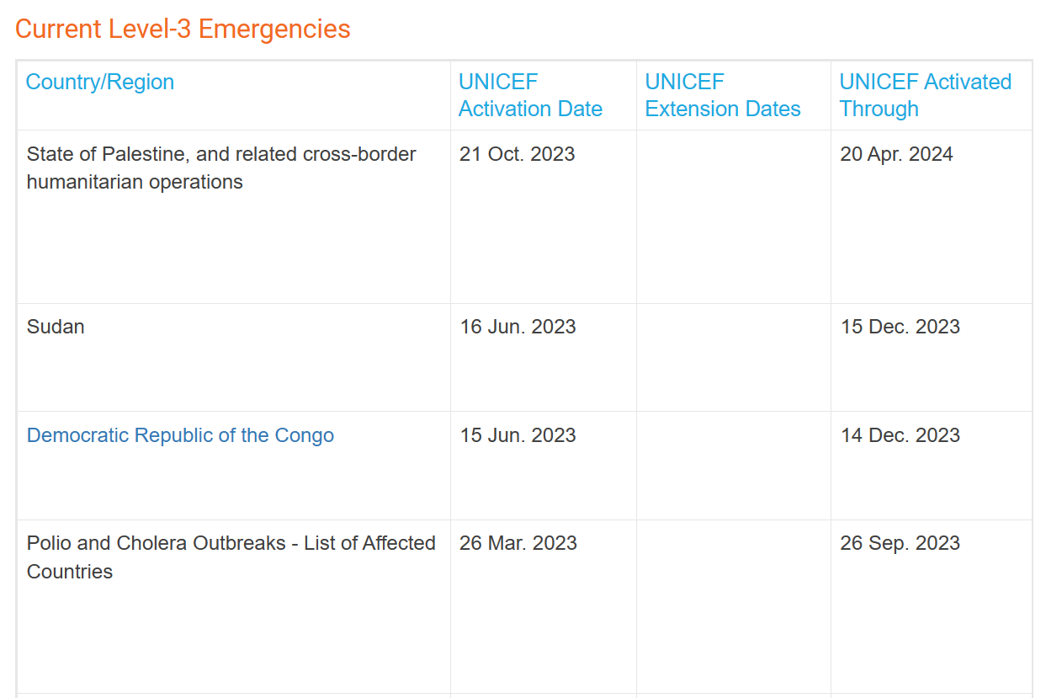

Slide 8
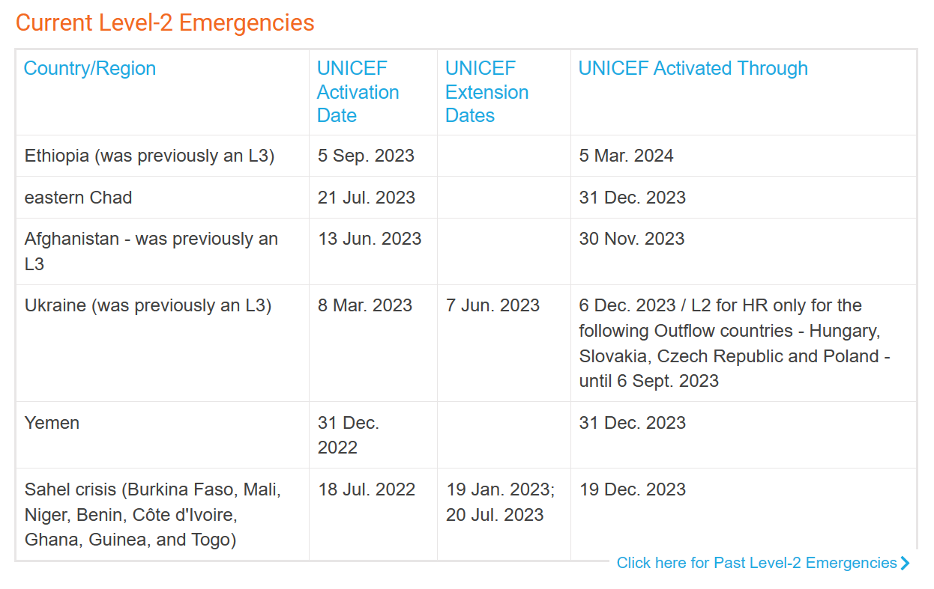

Slide 9
Resource Mobilization
Emergency
Procedures
RM Action Plan: Develop a Plan for the crisis if one is not already in place - within the 1st month of the declaration.
Reprogramme as much RR as required (with government approval) as well as ORR and ORE (with donor approval).
HAC: Develop (or update) the HAC appeal for the crisis. Outside the annual HAC process, develop only the external narrative, targets and budget requirements.
EPF allocation: No-regrets allocation of $5,750,000 (including $750,000 earmarked for PSEA). For L2s, no-regrets allocation of $2,500,000 (including $500,000 earmarked for PSEA).
Notes:
UNICEF is not a funding agency, but it mobilizes resource partners to advocate for additional funding.
• Timely Response: Partnerships will enable a rapid response to disasters triggered by early warning systems, ensuring immediate action for clean water, sanitation, and hygiene in affected areas.
• Resource Mobilization: Prearranged response mechanisms through CSO partners are expected to leverage additional financing to support partners from UNICEF donors.
• Strengthened Local Capacities: Partnerships empower communities, involve them in decision-making, and enhance their knowledge and skills for proactive disaster protection.
• Knowledge Sharing and Learning: Partnerships facilitate the exchange of best practices, strengthening the region's capacity to anticipate, respond to, and recover from WASH challenges.

Slide 10
Supply and Logistics
CrossCr-Sectoral Procedures

Slide 11
Supply & Logistics
Emergency
Procedures
Emergency Supply and Logistics Strategy: Activate, adapt or develop a Strategy.
For procurement under $10,000, follow the Quick Guide on Low Value Procurement.
Competitive bidding is not required, allowable to solicit an offer directly from a single source.
For L3s, Offshore procurement through SD of standard stock:
  First Wave via plane/charter dispatched 72 hours by charter flight;
  Second Wave to be delivered within 14 days by air;
  Third Wave: 60-90 days by sea.
Notes:
Competitive bidding is not required, it is allowed to solicit an offer directly from a single source. All simplifications applicable to procurement…

Slide 12
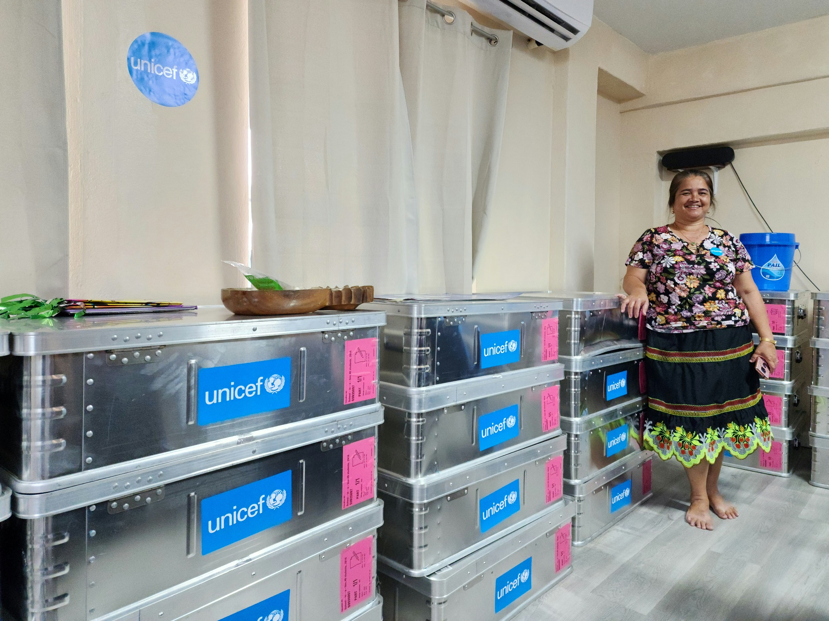

Emergency
Procedures
Prepositioning Supplies

Slide 13
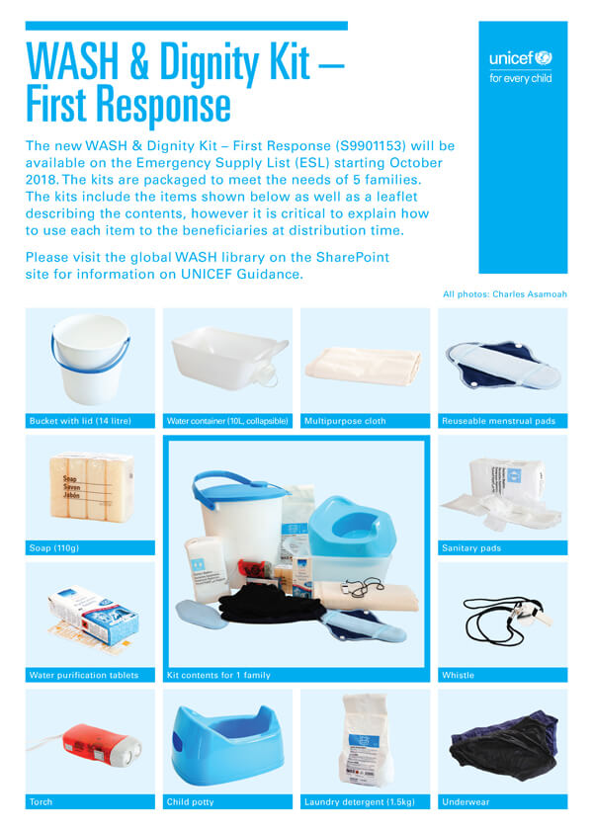
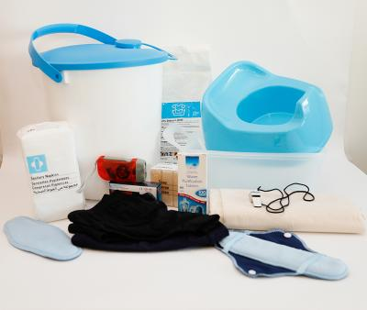
Prepositioning Supplies
WASH and Human Dignity Kit – 670 kits (1 per family)
Emergency
Procedures
Avril 2018
Notes:
The WASH (water, sanitation and hygiene) and Dignity Kit is a vital part of UNICEF’s work during crisis to meet the basic needs of children and their families, ensuring clean water, accessible sanitation facilities, and good hygiene practices in schools, health centers and urban settings.
2 x S5007311 - Water cont,PVC/PE,10l,collaps.,w/o logo 1 x S5007315 - Bucket,HDPE,with lid,14 litre 12 x S0552000 - Soap,toilet,bar,approx.110g,wrapped 1 x S5006286 - Torch, handheld, self- powered 1 x S5006275 - Child potty 2 x S5006276 - Multipurpose Cloth, cotton, 1x1.5m 2 x S5006271 - Reusable menstrual Pads,kit 2 x S5006282 - Sanitary pads,female,w/wings,disposables 1 x S5006313 - Whistle, for safety use, metal 1 x S5006283 - Underwear,female panties,qty 3x3 (S, M, L) 1 x S5006288 - Laundry detergent, 1.5kg 1 x S5006124 - Flyer 1p guide WASH&DignityKit,firstResp

Slide 14
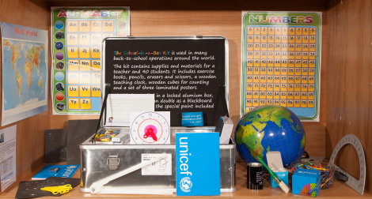
Prepositioning Supplies
School-in-a-Box Kit – 61 kits
Emergency
Procedures
Avril 2018
Notes:
School-in-a-box kit 2016, for 40 students and 1 teacher with 42 components packed in 1 lockable metal box. The module also contains guidance on psychosocial activities and on how to create of an inclusive class environment.

Slide 15
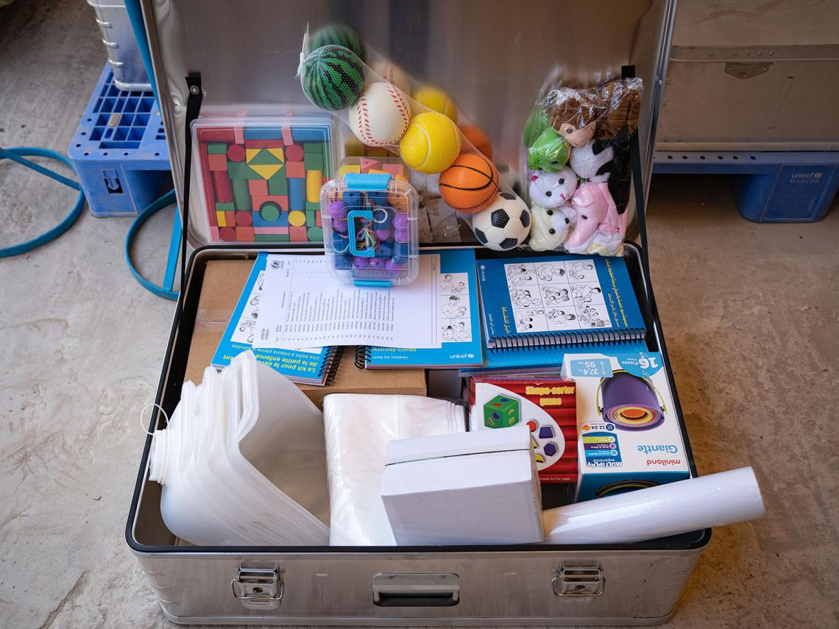
Prepositioning Supplies
ECD kit – 4 kits
Emergency
Procedures
Avril 2018
Notes:
Keep children playing and learning even during emergencies

Slide 16

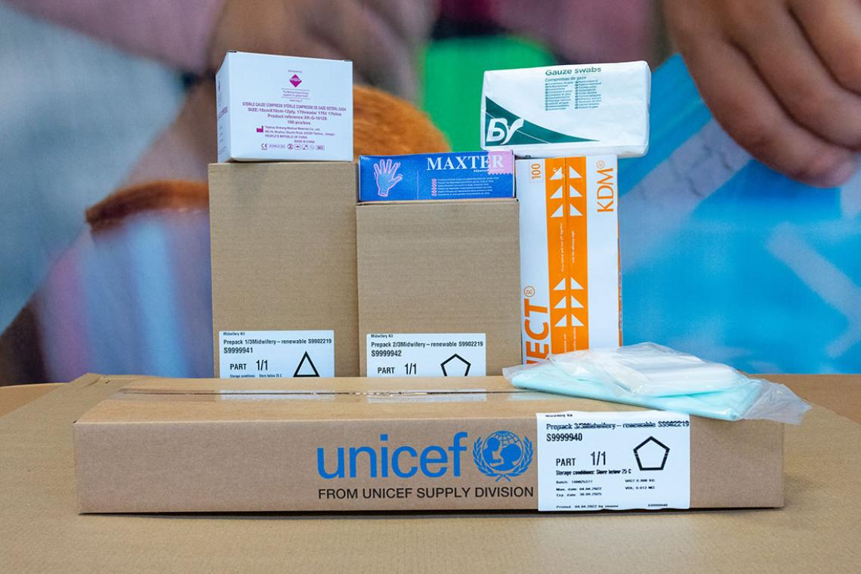
Prepositioning Supplies
Midwifery kit – 6 kits
Emergency
Procedures
Avril 2018
Notes:
The Midwifery Kit has been designed to improve maternal and neonatal care in situations of development and emergency.
The Midwifery Kit - Complete contains basic drugs, renewable medical supplies, medical equipment and basic sterilisation and resuscitation equipment for health facilities to perform an average of 50 normal deliveries.
Medical supplies that are part of UNICEF’s midwifery kit being packed in Copenhagen.

Slide 17
Capacity
Preposition Supplies
Brisbane - Australia
Honiara – Solomon Islands
Port Villa - Vanuatu
Pohnpei - FSM
Tarawa - Kiribati
Nadi - Fiji
Suva - Fiji
Offices
Vanuatu
Solomon
Kiribati
FSM
Samoa
Tonga
Fiji (MCO):Cook Islands, Republic of Marshall Islands, Nauru, Niue, Palau, Tokelau, Tuvalu,
Cluster lead or co-lead
WASH
Education
Health & Nutrition

Slide 18
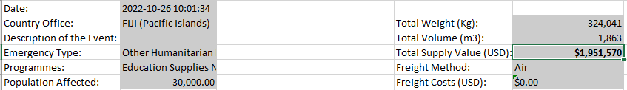
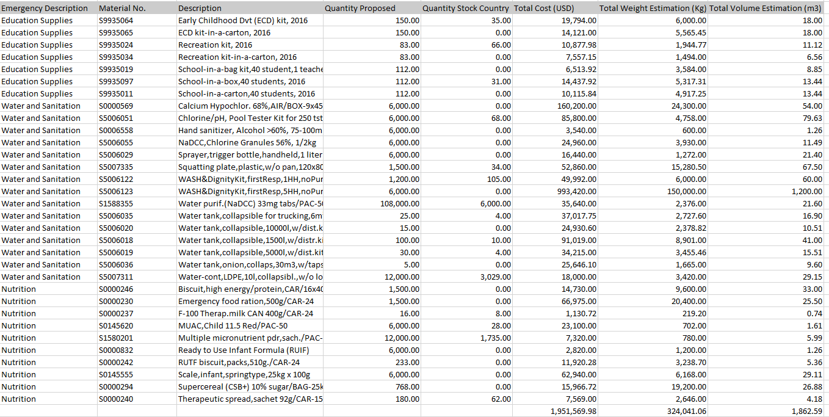
Supply needs

Slide 19
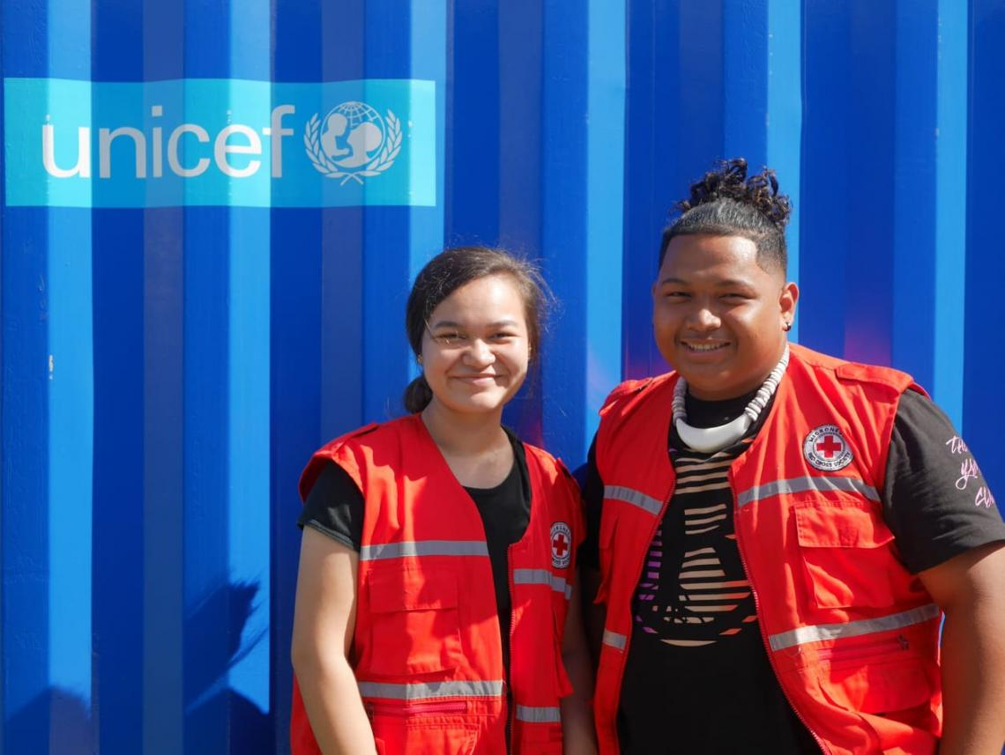
Thank You
Emergency
Procedures
THANK YOU

