Slide 1
FSM NAP Project National Inception and Implementation Planning Workshop
Session: Adaptation options and prioritisation

Slide 2
Objectives of the session
Understanding how adaptation options are identified/determined in FSM at different levels – national, state, island, municipality, general population, etc..
Articulate adaptation action and how they will address or response to climate impacts, vulnerabilities and risks
Understanding connection of adaptation actions to national policy frameworks
Understanding connection to investment priorities

Slide 3

Background
Mitigation
Reduction of GHG emissions
Adaptation
Adjusting systems to reduce risk
L&D Responses
Coping with residual risk and impacts
insufficient
insufficient
necessitates
necessitates
Climate
Change
Image source: Geographical Magazine
Adaptation barriers & limits
Lack of financial resources
Lack of knowledge & data
Lack of human resources
Biophysical constraints
(e.g. of crops)

Slide 4
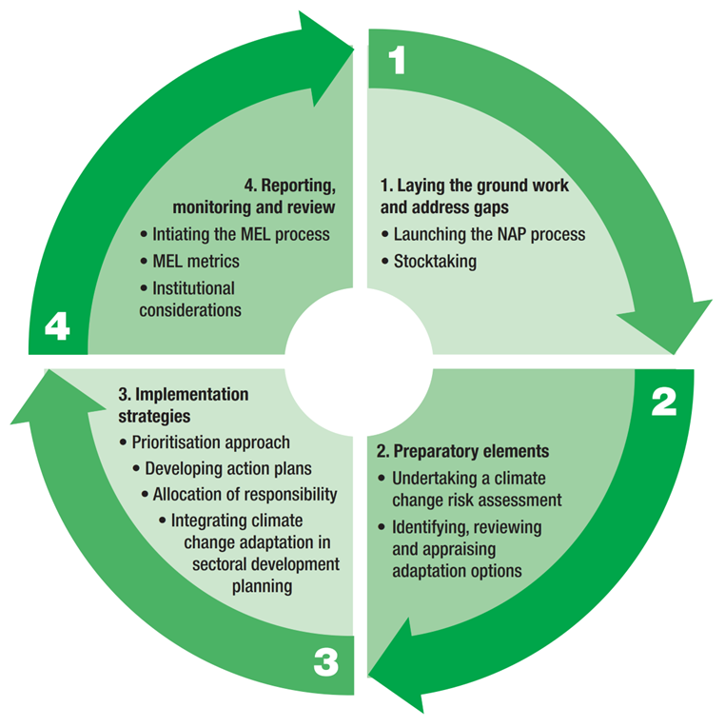
Pacific NAP Guideline: Adaptation planning process
  Plan how to reduce climate change vulnerability by enhancing adaptive capacity.
  Enables identification of medium and long-term adaptation needs
  Development of strategies and programmes to address those needs
  Its a continuous, progressive, and iterative process that follows a country-driven, gender-sensitive, participatory and fully transparent approach.
  Provides a framework for making better decision making
  Platform for raising climate finance for implementation

Slide 5
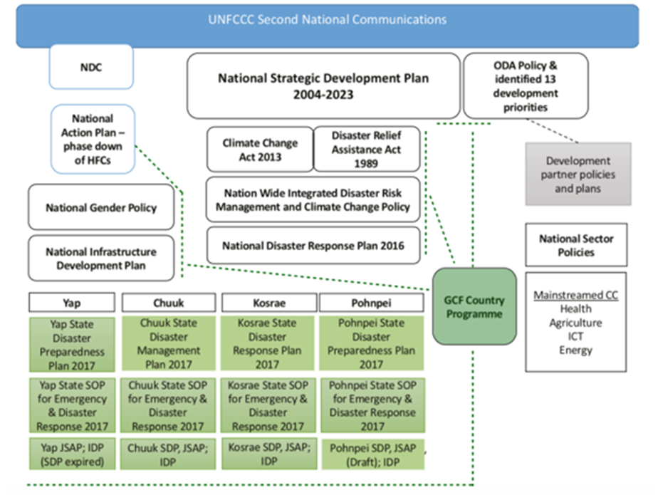
Existing Policy Landscape in FSM (project proposal phase)

Slide 6
Activity 1: Policy Frameworks and Documents
In your groups, discuss:
  Name three national and sectoral frameworks/strategies that you think is important to the implementation of the project and development of the National Adaptation Plan
  Are there any new policies that you are aware of? What are they and how are these linked to climate change adaptation?
  What are key lessons learned from implementation of these strategies or policies to date?
  Use flip chart to write your responses to the questions

Slide 7
Activity 2: Adaptation initiatives in FSM (past and current)
On your first sticky note please answer the following question:
Name up to 3 climate adaptation initiatives that you know of in FSM
On your second sticky note please answer the following question:
Name up to 3 disaster risk reduction related initiatives that you know of in FSM
On your third sticky note please answer the following question:
  Of the projects you’ve named, identify one with the greatest impact at improving resilience or adaptation?
  In your opinion what were 3 key reasons why it had great impact?
When you’ve completed all three questions, stick them on the appropriate column of the flip chart in front of you
Compare and consolidate sticky notes in each column.

Slide 8
Identifying, reviewing and appraising adaptation options
After risk assessment, the next step is to identify and select adaptation options to respond to climate risks.
Selection of adaptation options needs to consider their contribution to short-term and long-term sustainable development, their costs, effectiveness, and efficiency.
To ensure that the conditions for success are in place, it is also important to take lessons learned from past experiences in your country, and pilot projects/initiatives.
Adaptation options can be grouped:
  Hard measures (structural/physical measures)
  Social measures (soft options)
  Institutional measures (soft options)

Slide 9
Adaptation Options - Hard Measures
Engineered and built environment options, e.g. coastal protection and flood defence structures, building codes and transport and road infrastructure adaptation;
Technological options, e.g. new crop and animal varieties, efficient irrigation, and hazard mapping and monitoring technologies
Ecosystem-based options (also known as “green options”), e.g. wetland restoration, afforestation, and community-based natural resource management;
Services, e.g. social safety nets, municipal services and public health services.

Slide 10
Adaptation Options – Social Measures
Educational options, e.g., awareness-raising, sharing knowledge
Informational options, e.g., hazard and vulnerability mapping, systematic monitoring and remote sensing, and improved climate forecasts
Behavioural options e.g., evacuation planning, managed retreat, and economic diversification (such as new activity or changing practices to take advantage of changing climatic conditions).

Slide 11
Adaptation Options – Institutional measures
Economic options, e.g., taxes and subsidies, off-setting losses by sharing or spreading risks through insurance, and financial transfers
Laws and regulations, e.g., land zoning laws, building standards, and disaster planning and preparedness
Government policies and programs, e.g., regional and sectoral action plans, city-level plans, adaptive management approaches.

Slide 12
Other important considerations
Some of these adaptation options may involve incrementally adjusting current development activities (e.g., climate-proofing or building resilience of existing systems)
Other options may require major transformations in systems, operations and planning
Spatial scale of the action - local, national or regional
Indication of urgency based on the timing, expected level and severity of expected impacts
Decision lifetime of the adaptation option - this involves both the lead time required to plan and implement the action, and the consequence period of the action (impact).
  Short lead + short consequence period (which crop cultivar to plant)
  Short lead + long consequence (building a house)
  Long lead + short consequence (breeding a climate-resilient crop variety). 
  Long lead + long consequence (location of a new suburb outside of a coastal hazard zone).
Adaptation options should be overlapping rather than discrete
Common assessment criterion: Effective, least cost and minimise risks associated with implementation

Slide 13
Activity 3: Adaptation options
Use flip chart to make a long list of adaptation options that responds to the climate risks identified from previous session.
Use a post it note to identify adaptation options that are implementable at the national level, state level, municipality level and state why you think this is appropriate?

Slide 14
Adaptation Options Prioritisation Process
Developing an appraisal tool or using combinations of various methods for sticky decisions:
Group or public perceptions
Approach to incorporate public perception as data points for site specific options or more generally as values in criteria development for further analysis
Multi-criteria analysis
Compares options against a suite of indicators and criteria. Suitable approach for filtering options before applying more detailed quantitative analysis, or to compare options where impacts are not easily quantifiable
Cost-benefit analysis
A systematic approach to comparing strengths and weaknesses of options, particularly against their financial and resource costs
Geospatial analysis
Use of GIS-based tools to select an adaptation option e.g. a location that is less exposed to relocate coastal communities.
Common assessment criteria: urgency, cost, options that maximise co-benefits;

Slide 15
Activity 4: Prioritisation and appraisal of adaptation options
Use the list of adaptation options you have developed.
Discuss what methods, metrics, values, aspects or approaches that are appropriate/important to FSM that must be considered in when prioritising and appraising adaptation options? List what these are and state why you think its important

