Slide 1
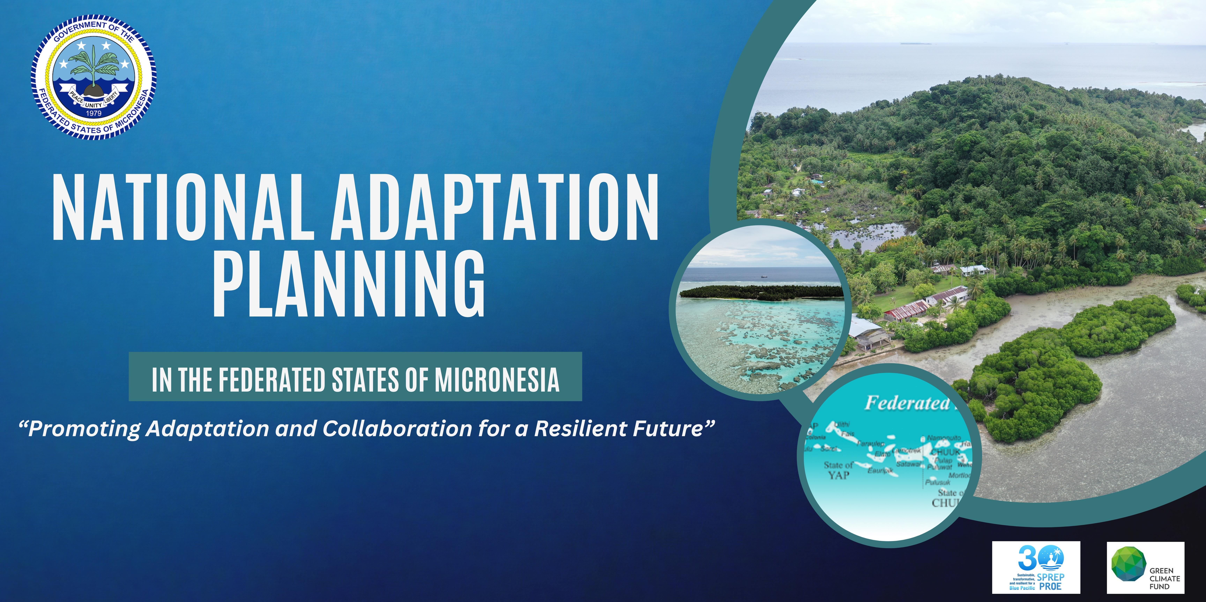

Slide 2
National Adaptation Planning in the Federated States of Micronesia
FSM NAP project
Inception Program
August 26-28, 2024
Tuna Commission Annex Building
Notes:
NAP workshop onjectives are To:

Slide 3
FSM Adaptation Plan
Inception Workshop Objectives
Introduce the project, its objectives, activities, intended outputs, approaches and timeline.
Consult with national stakeholder on project direction and exchange knowledge of adaptation gaps and needs, challenges and lessons learnt from similar projects.
Exchange knowledge on key attributes of the adaptation planning process.
Notes:
And a brief background of our FSM Adaptaion Plan which

Slide 4
FSM NATIONAL ADAPTAION PLAN
Brief Background
The NAP process was developed under the United Nations Framework convention on Climate Change to help countries conduct comprehensive medium and long term adaptation planning
Flexible process that builds on our existing adaptation activities and help integrate climate change into naitonal decision making process
Expected to increase coordination and investments in climate adaptaion with the ultimate objective to reduce FSM’s vulnerability to climate impacts
Notes:
Therefore, in

Slide 5
NATIONAL ADAPTAION PROGRAM (NAP)
PROGRESS
April 2019, the Government of FSM through FSM Department of Environment, Climate Change and Emergency Management, (DECEM) officially requested Secretariat of the Pacific Regional Environment Programme, (SPREP) to be their delivery partner for the development and implementation of the FSM National Adaptation Plan (NAP) Proposal to the Green Climate Fund (GCF).
October 2019, a consultation stakeholder meeting was held in Pohnpei. The mission was designed to plan for and inform the perparation of the NAP proposal.
March 2022, the initial submission of the proposal
March 2023, resubmission with Version number v.03.
Notes:
And to add on these important events, today August 26, 2024, marks a significant milestone in our ongoing efforts to build more resilient and sustainable future for our nation. This is somehow FSM NAP came about.

Slide 6
National Adaptation Program (NAP)
PURPOSE
This proposal will develop an overarching National Adaptation Plan (NAP) for the FSM through a comprehensive consultative adaptation planning process, evidence base and climate finance investment plan for adaptation including developing potential draft project /programme concept note
The project will support state and national level climate change staff, private sector participation, as well as urban and rural communities through strengthened governance mechanisms, an enhanced evidence base for climate change adaptation planning, and increased support to access climate finance.

Slide 7
National Adaptdation Planning Project Overview
3 year project
mainly for the first year will be consultations, than awareness raising and the last year of the project will be on training and capacity development
Funded by Green Climate Fund (GCF) US $2, 996,147.00
Through the Secretariat of the Pacific Regional Environment Programme (SPREP)
Executed by the Department of Environment, Climate change, and Emergency Management (DECEM).
February 2022 was the initial submission and again in March 2023 was resubmitted with version .03

Slide 8
Project Objectives
Introduce the project, its objectives, activities, intended outputs, approaches and timeline.
Consult with national stakeholder on project direction and exchange knowledge of adaptation gaps and needs, challenges and lessons learnt from similar projects.
Exchange knowledge on key attributes of the adaptation planning process.

Slide 9
NATIONAL ADAPTATION Planning
Project Outcomes

Slide 10
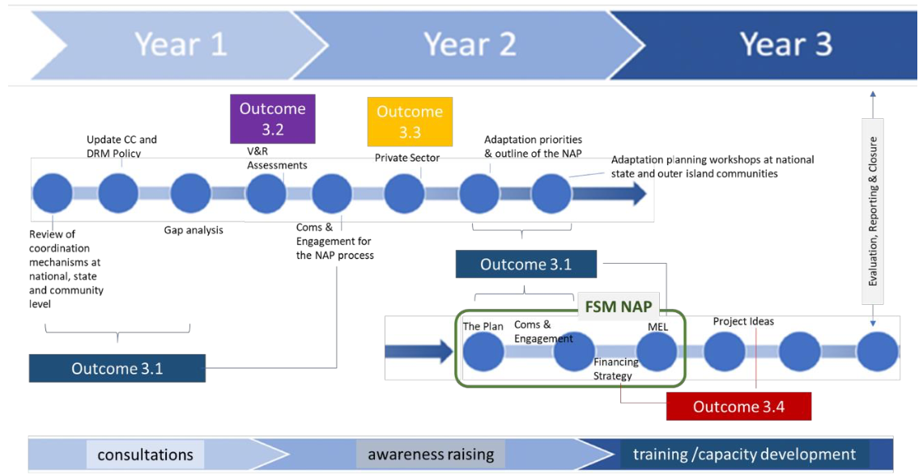
Notes:
#1:-Strengthening adaptation planning governance and institutional coordination
-#1 – Adaptation planning governance and institution coordination
- limited policy coordination between the national, state and local level, and the need to streamline adaptation planning across all states
- the lack of capacity at National and state level to undertake effecttive adaptation planning and records.
#2 – Evidence basis to design adaptation solutions for maximum impact
The NAP will update climate projections and impact scenarios including hazard zones based on the new scientific information issued by the ipcc using the 2011 Pacific Australia Climate Change Science and Adaptation Planning Project as the baseline
#3 -Private sector engagement in adaptation catalyzed
To ensure their support and commitment, involved right from the start
#4 - Increasing adaptation financing
The NAP will assess the financial options and modalities for current and future sources of adaptation financing

Slide 11
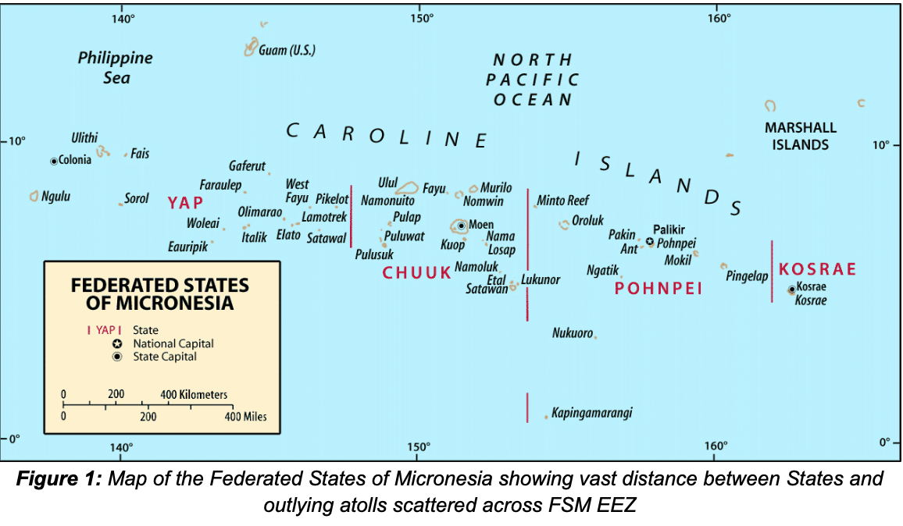
Notes:
The Federated States of Micronesia (FSM) is an island nation comprised of 607 dispersed islands in the north-western Pacific Ocean. The FSM is an independent sovereign nation in free association
with the United States of America made up of four semi-autonomous states; Pohnpei, Kosrae, Yap
and Chuuk.
Each of the four States is centered on one or more islands with numerous outlying atolls except for the State of Kosrae.
Land elevations range up to approximately 760 meters (2500 feet) but the majority are relatively flat, small, swampy with low-lying forested atoll islets typically 1-5 meters above mean sea level
Based on the 2020 Population and Housing the total population of the FSM is 104,54
State of Chuuk has the highest total population at 48%, Pohnpei State at 35%, Yap at 11% and Kosrae with the lowest of 6%
FFSM Government has 4 levels of governance
The National level, state, municipality and tradition, with most of the government functions carried out at State Levels except foreign policy and national defense.
Given their uniqueness culture, location, set up…
each state has different levels of development, priorities, issues, needs and problems…
INORDER to ensure ownership, implementation of FSM NAP project, each States has their own adopt a plan
(State) Joint State Action Plan for Risk Management and Climate Change (JSAP)
Each State JSAP should be custom fit/ tailored to state need and development
JSAP’s also Need to be reviewed and revised base on each States need
National level, we facilitate the process… each state comes up with their reviewed and revised JSAP’s,

Slide 12
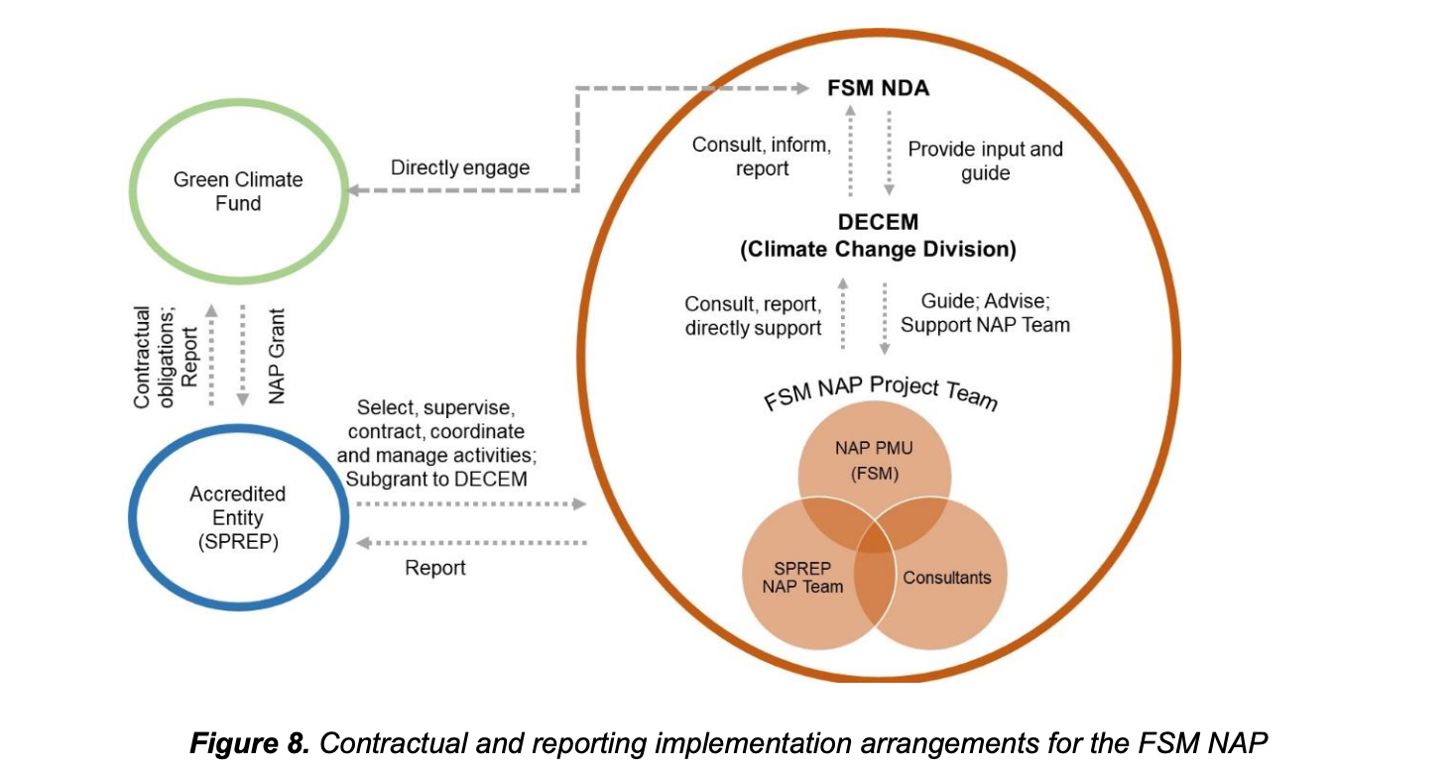
Notes:
SPREP, the Delivery Partner, will be responsible for implementation of the readiness support and will carry out
all fiduciary and financial management, procurement of goods and services, monitoring and reporting activities
under this proposal in compliance with SPREP’s policies and procedures and with the Bilateral Grant
Agreement to be signed with GCF.

Slide 13
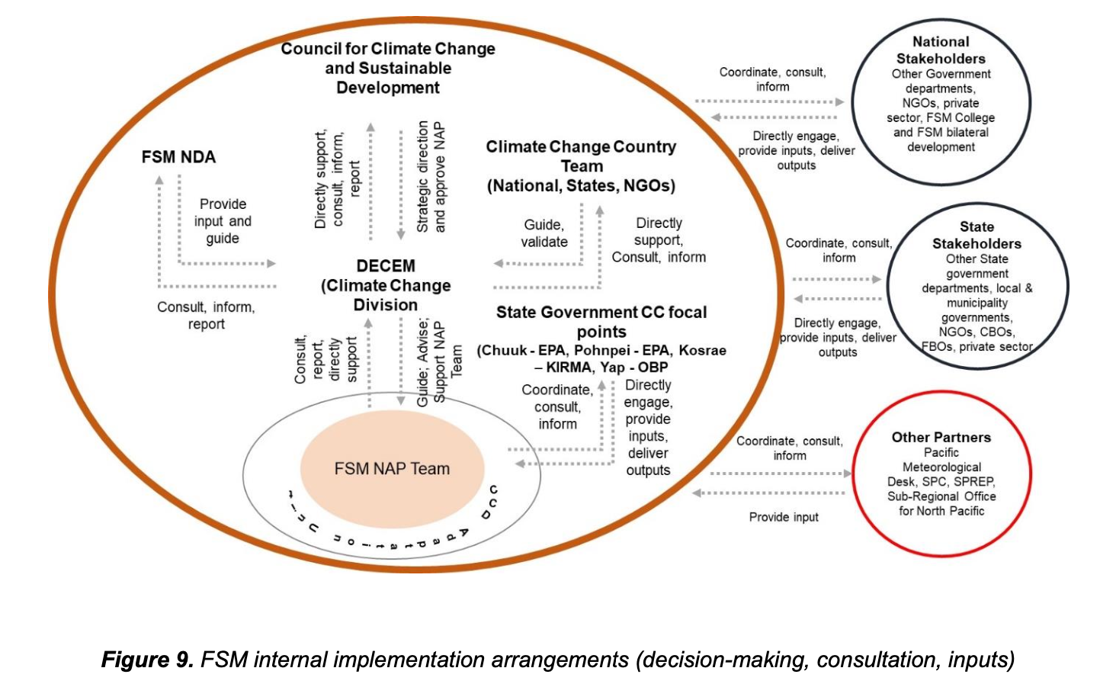
Notes:
The in-country activities will be managed by the Government of FSM through the Department of Environment,
Climate Change and Emergency Management (DECEM). A project agreement between SPREP and DECEM
will be executed, along with a capacity assessment of DECEM69
, to provide for the transfer of funds to DECEM
for specific on-ground activities. This will enable more effective oversighting of in-country activities including
stakeholder consultations, DECEM office management responsibilities etc. DECEM will be responsible for any
fiducial requirements relating to these funds, and terms and conditions, including reporting will be detailed in
the project agreement.
The budget plan has been further detailed to outline the specific outputs and funds to be managed directly by
DECEM. These are summarised in Table 6.
The NAP Project Coordination Unit (NAP PCU) will be established in the Adaptation Unit of the Climate
Change Division of DECEM and two local consultants (Project Manager and Project Finance and
Administration Officer) will be recruited by DECEM to manage this unit. Further, four State Climate Change
Coordinators will be recruited by SPREP and placed in each state to coordinate state on-ground activities. The
experience of having State Climate Change Coordinators was commented in the Mid-term review of the
Adaptation Fund FSM project where they were instrumental in ensuring that project activities are coordinated
and executed as planned. The NAP project will utilize such arrangements to ensure that the NAP process is
widely executed in the FSM. The NAP team will be further strengthened through the procurement of local and
international consultants (engaged by SPREP) to work in close collaboration with DECEM to deliver specific
activities of the project.

Slide 14
Background to adaptation planning in the FSM

Slide 15
Nation Wide Integrated Disaster Risk Management and Climate Change Policy 2013
Provide an overarching framework for integrating disaster risk management and climate change adaptation consideration into FSM’s development.
This Policy supersedes and is an update of the Nationwide climate change policy of 2009.
It supports FSM’s SDP 2004-2023 and broadly aims to “achieve economic growth and self-reliance while also maximizing the opportunities presented by climate change.”
This policy identifies nine guiding principals such as:
1. Strong Horizontal and vertial coordination between sectors
2. knowledge based decision making
Notes:
Out of the 14 key policies that are interconnects with our FSM National Adaptation Plan

Slide 16
Nation Wide Integrated Disaster Risk Management and Climate Change Policy 2013
(Con’t)
3. Ridge to Reef approach to risk reduction
4. Strategic outcomes
5. Objectives related to climate change adaptation
6. Capacity building
7. Public awareness raising strategies

Slide 17
Climate Change Act 2013
A. Created to implement provisions of FSM’s Nationwide Intergrated Disaster and Climate Change Policy (CC Policy)
B. The ACT provides
- A framework for developing further legislation on climate change
- Identifies for developing further legislation on climate change
- Outlines their specific duties
- Calls for the President of FSM to submit an annual report on progress made to the Congress.

Slide 18
Joint State Action Plans (JSAPs)
JSAPs play a significant role in FSM’s National and regional climate change adaptation activities, not only do they build a foundation to inform planning and mainstreaming at the national level, but they alos provide localized and regional knowledge on the barriers and needs unique to each state.
- The current JSAPs are heavily focused on disaster risk management (DRM) and have much less detail on adaptation.

Slide 19
Thank you

